Slide 1
KX-NS Step by Step Guide Software Update
May 9, 2014
Panasonic System Networks PBX SE team
Specifications are subject to change without notice.

Slide 2
Chapter 1 Version Confirmation

Slide 3
11. Confirm current Software Version.
< KX-NS1000 >

Slide 4
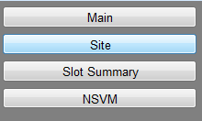
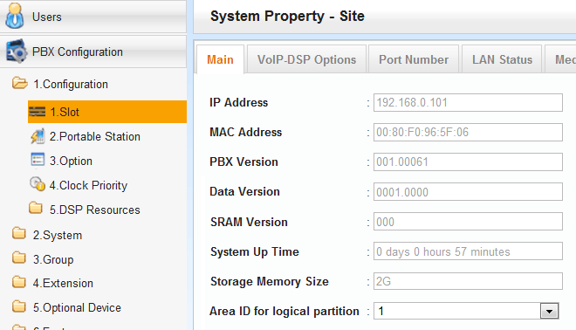
12. Confirm current Software Version.
< Other KX-NS PBX >
SD card size is also can be confirmed.

Slide 5
13. Confirm current Card Software Version.
< Other KX-NS PBX >

Slide 6
Chapter 2 Software Copy to PBX
This step is same as software file copy to SD card of KX-TDA. - Software for KX-NT/UT, IP-CS and PBX hardware can be copied. - Software has to be downloaded to PC before this step.

Slide 7
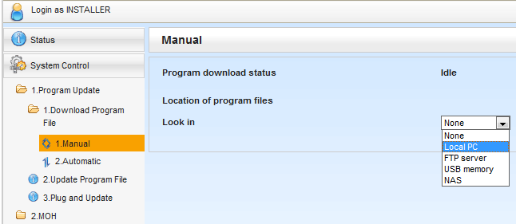
21. Select Software file in PC.
USB | Download from USB memory connected with USB port of KX-NS PBX.
FTP | Download from FTP server directly. It is not required to download to PC before this step, in this case.
NAS | Download from NAS directly.
Master Unit | When log-in to slave unit, software can be downloaded from KX-NS1000 master unit.

Slide 8
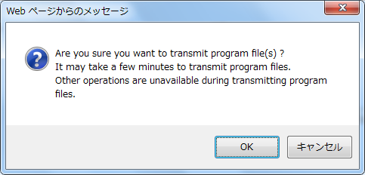
22. Click [OK].

Slide 9
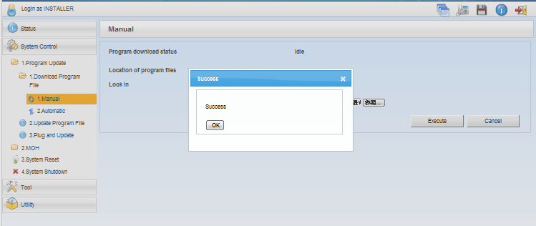
23. Click [OK].

Slide 10
Chapter 3 Software Activation

Slide 11
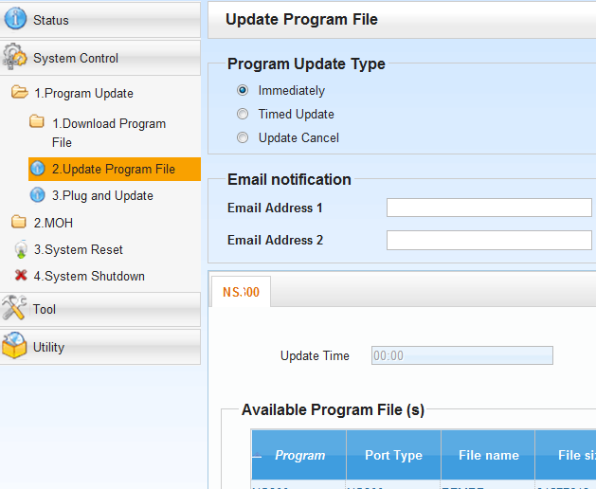
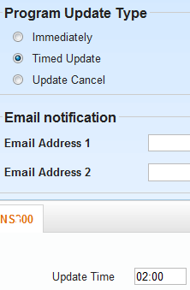
31. Select Immediate or Timed.
Software can be activated immediately or at desired time. Result of update can be e-mailed.

Slide 12
32. Select Target.
New Version
Current Version

Slide 13
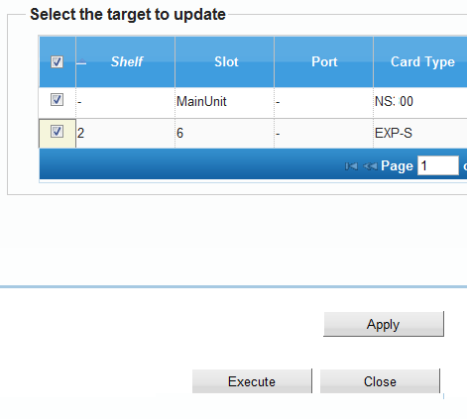
33. Start Activation of Software Update.
1. Click [Apply] (Do NOT forget [Apply].) 2. Click [Execute].

Slide 14
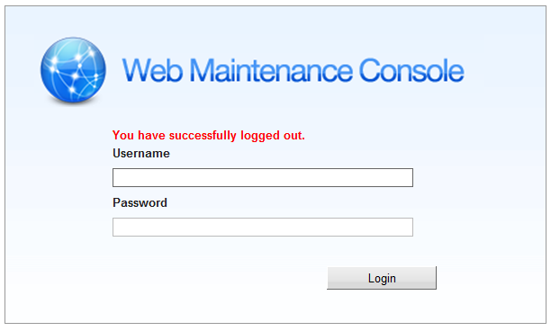
34. Wait for 20 minutes.
If target is PBX main software, web-MC is automatically logged out and wait for 20 minutes.
LED
Slow Flash
20 min
On

Slide 15
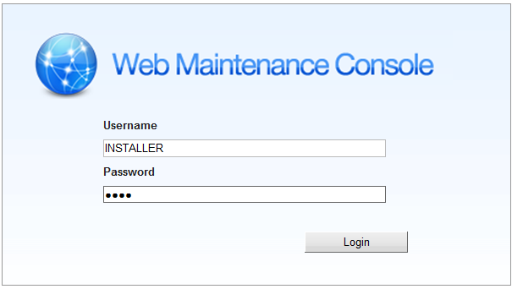
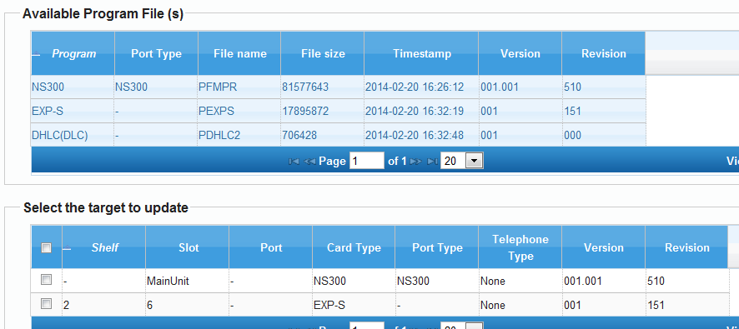
35. Log-in and Confirm Version.

Slide 16
Chapter 4 Conditions

Slide 17
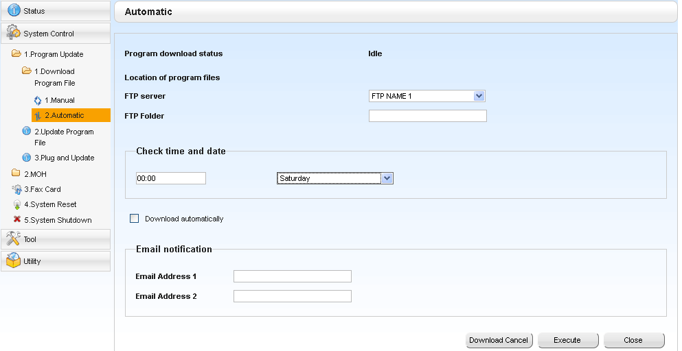
41. Automatic software download to PBX
Software can be downloaded from pre-programmed ftp automatically. (Ftp server has to be prepared.)

Slide 18
Thank you !

Slide 19
Revision
Date | No. | Change
Sep 11 | - | First edition
Dec 14 | 11/12 | This page was added for software version confirmation.
 | 33 | Picture was added about waiting for 20 min.
Feb 22 | All | Software for expansion cabinet was added as example.
May 9 | 12 (Page 4) | SD card size also can be confirmed.
Notes:
19

